Slide 1


Slide 2
National Tournament Judge Training Topics
Certified Leaders have the ultimate goal of inspiring others, they stand out among the crowd. Being a National Tournament Judge gives you the ability to inspire and influence on an even bigger stage. The July National is our signature event of the year, and we need our National Tournament Judges dedicated to increasing the competitor and spectator experience.
National Tournament Judges are:
  Professional
  Confident
  Efficient
Enjoy the prestige of being a National Tournament Judge
  1.5 hour lunch break
  Complimentary lunch voucher
  Judges only break area

Slide 3
Inspire
Communication:
  Needs to be effective, meaning it’s delivered in a direct yet personal way.
  Use your voice to demonstrate excitement, passion, and confidence
Culture:
  Establishing ring culture starts at the very beginning. As competitors and spectators enter the Competitor Pod welcome and introduce yourself to each one
  Explain the spirit of competition, and remind competitors and spectators to be respectful and demonstrate sportsmanlike conduct
Behaviors and Stature in Action:
  Your body language shows more about your passion and the desire to be there than anything else.
Respect and Timeline Awareness:
  When you are in the spotlight, remember to have fun and be respectful, you set the tone of the ring, so make it an inviting and fun one.
  Be aware of your timeline, speed and efficiency of a competition depends on the functioning of each ring.
Safety:
  The most important aspect of competition is safety. Safety is achieved through close adherence to courtesy and sportsmanship.
  Medical staff has final say on if a competitor continues after an injury

Slide 4
Pod System
6 Mat Competition Pod
  Two Competition Stations = 1 Competition Pod
  1A, 1B, 1P2/B
  2A, 2B, 2P2/B

Slide 5
A & B Brackets
A & B Brackets are used for both form and sparring
First round determines the bracket
  Winner of round 1 goes into “A” bracket
  Loser of round 1 goes into “B” bracket
4 matches on two mats simultaneously to determine A & B brackets

Slide 6
Byes & Competitor Pairing
Competition for all form and sparring is single elimination head to head matchups using the bye/pairing system (does not apply to player 2 or XP weapons).
Step by step process
  Count the number of competitors
  Refer to Bye Sheet to determine the number of byes
  Line competitors up, each competitor selects a laminated number card
  Beginning with number 1 assign byes in sequence until required number of byes are assigned
  After byes are assigned create first round pairings using the continuing number sequence
  Call out bye results and have those competitors stand in single line
  Call out first round competitor pairing results and have those competitors stand side by side
  Record name, collect cards, begin competition

Slide 7
Safety
Judges are required to stop the competition and have the first aid medical team inspect the student if
  The judges observe an injury, anxiety or fear on the part of a competitor
  If a competitor requests first aid
  If a parent or guardian requests first aid
Judges, parents or competitors are not allowed to let a competitor continue under any circumstances if any member of a first aid medical team advises that the competitor not continue
If as a result of a kick or strike that was delivered with aggressive contact the match must be stopped to assess. If at any time a medical staff advises not to continue no judge or willingness of the competitor can override the medical staff (like concussion protocol, medical evaluation determines continuing, not choice)

Slide 8
Center & Corner Judges
The Center Judge is responsible for the individual competition ring
  Be ready to communicate effectively process and expectations for competition
  Use your time efficiently, delegate tasks to corner judges (certificates, medals, paperwork)
  Refer to Pod Director with any questions or issues
Corner Judges
  Help facilitate completion of the competition ring
  Be an active judge (move with the competitors/stay engaged with the competition)

Slide 9
Form
Forms are head to head battles
Only performed once
Each Judge decides winner based on”
  Neither of the competitors made a mistake; best artistic/athletic performance wins
  One competitor makes a mistake and other did not; competitor not making mistake wins
  Both competitors make a mistake; best artistic/athletic performance wins
Judges do not consult on scores or mistakes, Center Judge says Judges score
Judges raise flags indicating their individual decision
Majority flags determine winner

Slide 10
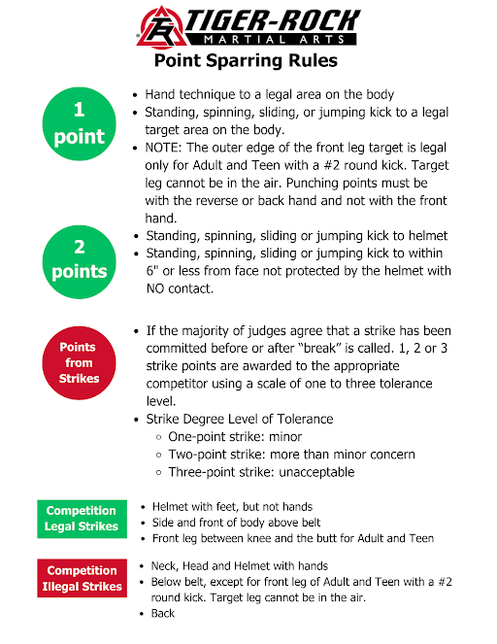
Sparring Quick Reference

Slide 11
Player 2 Sparring
To score points students must make exact contact and strike with conviction while following the Player 2 Progressive Combination
There are two judges (one for each competitor) each with clickers recording points for Player 2 Sparring
If a mistake is made in the combination (wrong technique, wrong side or skipped technique) the judges immediately stops the student with instructors to reset and start the combination over
The match will stop at 30 seconds to allow judges to switch sides and clickers to continue with the final 30 seconds, allowing for judging balance.
At the end of the full 60 second round, judges will record total points for each competitor
Point totals are used to determine winners rather than single elimination, however 2 students perform side by side to inspire each other to individually accumulate points.
Punch Points: all targets one point
Kick Points
  Bottom row of numbers one point
  Middle row of numbers two points
  Top row of numbers three points, only round kicks to top row (no front or side kicks)
White belts perom first 3 of combination only
Yellow belts and above perform all 5 of the combination

Slide 12
Breaking
Color Belts
  #3 Side Kick (Bag)
  #2 Front Kick (Bag)
  Palm Heel or Hammer Fist (Ground)
  Downward Elbow (Ground)
Black Belts
  Jump #3 Front Kick (Bag)
  Spin Side Kick (Bag)
  Palm Heel or Punch (Ground)
  Downward Elbow (Ground)
Medals
  4 out of 4 - Gold
  3 out of 4 - Silver
  2 out of 4 - Bronze

Slide 13
Friday Medals
Competitors on the Friday Open Competition receive the event themed medals.
Gold medalist in “A” bracket form or sparring competition receive an All Star invite for Saturday competition

Slide 14
Saturday Medals
All medalist on Saturday receive the All Star medals.

Slide 15
Communication
Needs to be effective, meaning it’s delivered in a direct yet personal way.
Use your voice to demonstrate excitement, passion, and confidence
Great emphasis should be placed on tone and content of the message.
Utilize Transformational language
  Inclusive
  Action-Oriented
  Positive/Affirmative
  Process-Oriented
  Awareness-Oriented
Speak clearly, positively, and to the point.
Be loud enough for all in your area to be able to hear, but not so loud that you are interrupting other competition rings.

Slide 16
Efficiency & Speed
All of our events should run smoothly and with a sense of urgency
Review your resources and assignments prior to the event
Maintain a professional manner at all times
Stick to the timelines, but do not rush - be sure to double check all results and how it is recorded

